Slide 1

Full Stack .NET Core
Christoph Biegner
dotnetdev@biegner.de

Slide 2
Agenda
Software
What‘s it all about?
And what‘s it not about?
Developer, Developer, Developer
Live Action

Slide 3
Software
Visual Studio Community 2017 (© Microsoft) https://visualstudio.microsoft.com/
.NET Core Framework 2.1 (© Microsoft) https://www.microsoft.com/net/download
Postman (© Postdot Technologies, Inc.) https://www.getpostman.com/
Microsoft Edge (© Microsoft) https://www.microsoft.com/de-de/windows/microsoft-edge

Slide 4
What‘s it all about?
.NET Core
WebAPI / REST
Testing
Structure

Slide 5
And what‘s it not about?
.NET Core Entity Framework
Dependancy Injection
RestSharp
Docker
Razor
Security

Slide 6
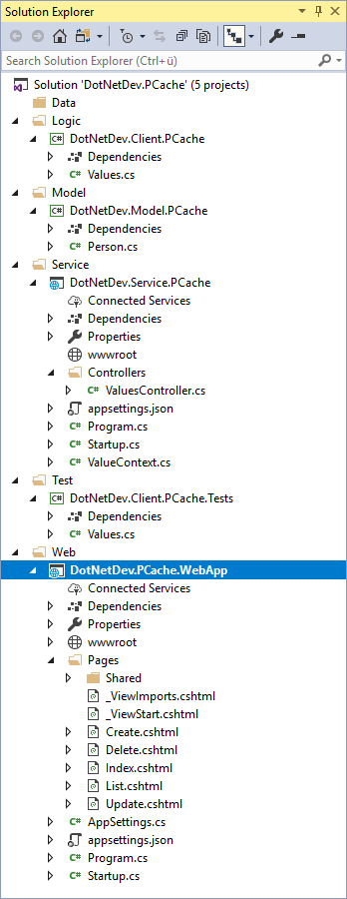
Developer, Developer, Developer…
File system structure (/dev, /dev/svc, /dev/tst, /dev/web, /dev/dta, /dev/lgc, /dev/mdl)
Add Model
Add Service
Add Client
Add Test
Add WebbApp
Test Service with Postman
Test Client with MSTest

Slide 7

Live Action…

Slide 8
What happened…?
Creating a .NET Core WebAPI / REST Service
Running the Service
Testing with Postman
Creating a reuseable Client Library
Testing / Debugging Client Library with MSTest
Creating a WebApp

Slide 9
What happens next…?
Docker Support
Security / API Management
Store data (e.g. CosmosDB) / Entity Framework
… (you tell me)

Slide 10
Thank you!
Any Questions?
Christoph Biegner
dotnetdev@biegner.de
github.com/cbiegner

